Slide 1
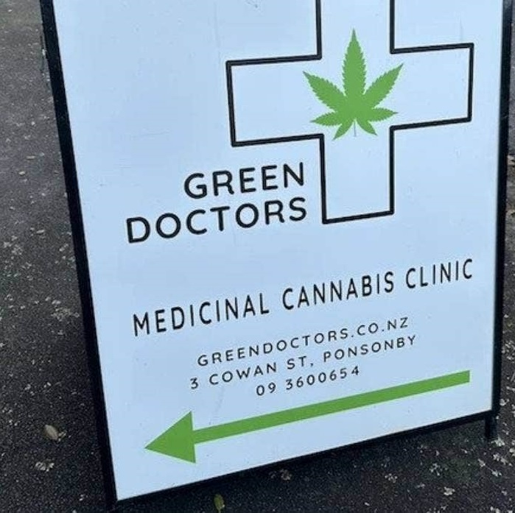
Medicinal Cannabis Scheme in New Zealand: Six emerging trends”.
Medicinal Cannabis Scheme in New Zealand: Six emerging trends
Marta Rychert, PhD
Senior Researcher,
Massey University, New Zealand
m.rychert@massey.ac.nz

Slide 2
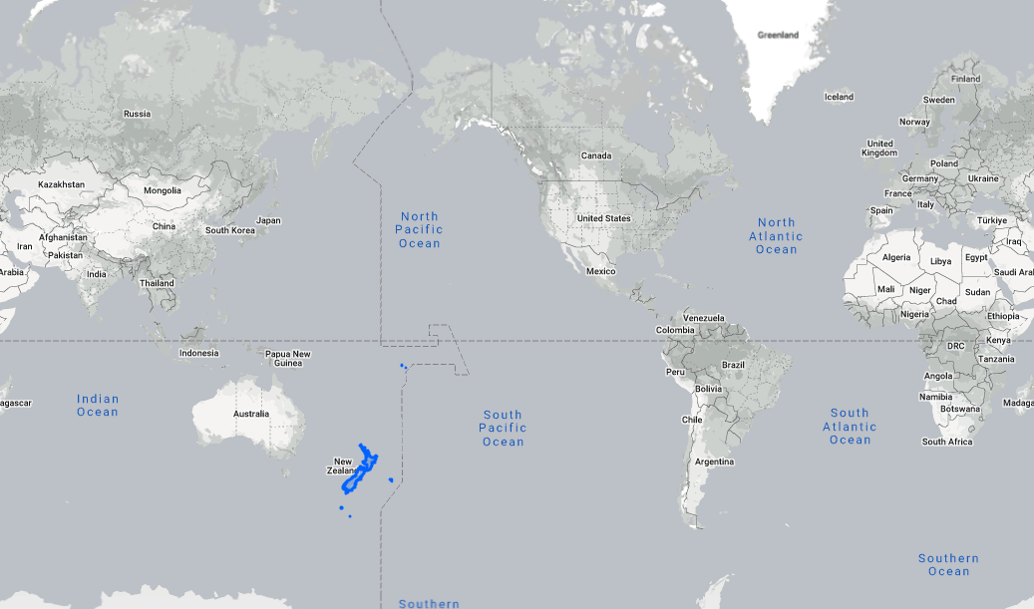
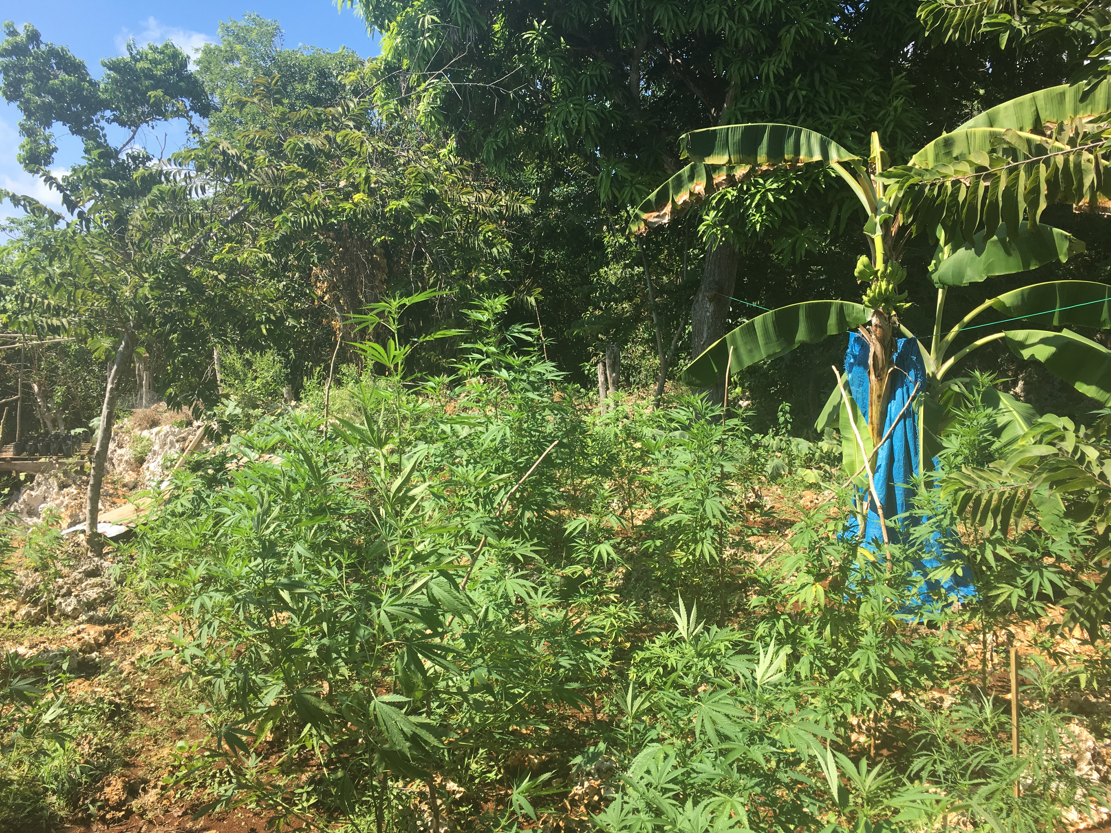
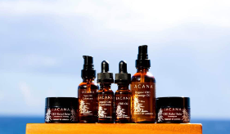
2001, 2018
2015
2013
2018, 2020

Slide 3
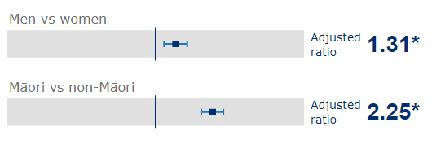
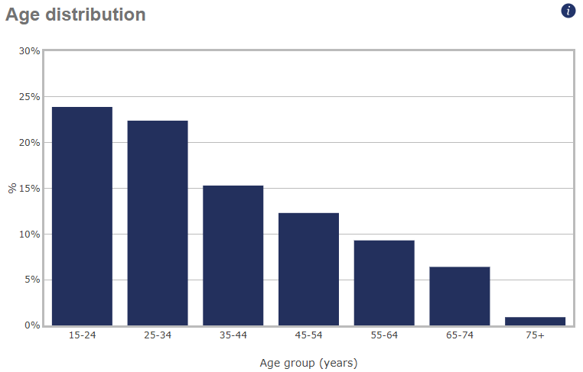
Cannabis consumption (NZ Health Survey – 2022/23)
14.2% of adults (16+) used cannabis in the past year
4.7% weekly or more frequently in the past year
2012/13 NZ Health Survey:
4.6% used cannabis for medicinal purposes(prevalence was 9.4% at the time)
→ Approximately 1 in 2 cannabis consumers used for medicinal purposes

Slide 4
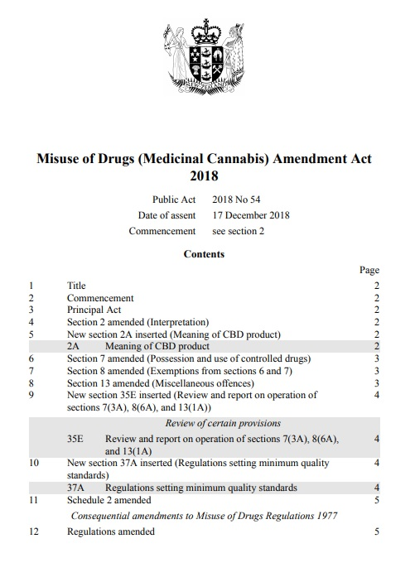
“This bill amends the Misuse of Drugs Act 1975. It is a bill about cultivation, cannabidiol, and compassion.”
December 2018
April 2020
March 2021
October 2021
September 2024
Medicinal Cannabis Scheme finalised
Any health condition
Any doctor (includes GPs)
First product ‘approved’
First domestic product ‘approved’
45+ products

Slide 5

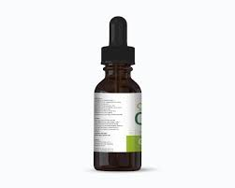
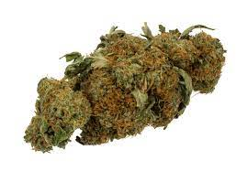
PRODUCTS
PRESCRIBERS
Must meet Minimum Quality Standards, no evidence of efficacy required
CBD / THC
for vaping or use as tea (not smoking!)
Notes:
(a) in pharmaceutical-dosage delivery form (e.g. pills, tinctures) +
(b) dried herb for vaping or use as tea (not intended for smoking) (due to concerns about respiratory risks)

Slide 6
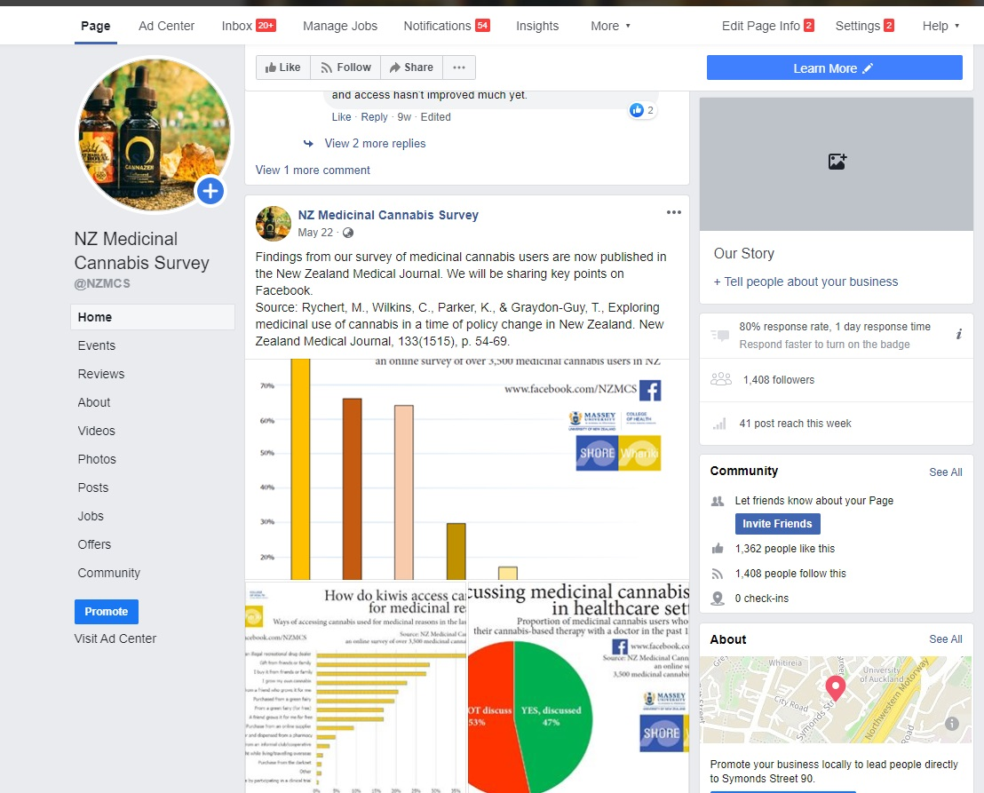


We conduct large-scale online surveys to monitor medicinal cannabis users’ engagement with the legal scheme, patterns of use, conditions, ROA, product preferences…:
→ NZ Medicinal Cannabis Survey (2019/20: 3,634 last year med can users)
→ NZ Drug Trends Survey (annual survey of drug markets and use, 10-25k respondents, med can module)
Qualitative face-to-face interviews with consumers and doctors: patients, doctors, women consumers…
Administrative data: products, prescribing, prices…

Slide 7
SUPPLY & PRESCRIBING
PRODUCT AVAILABILITY: THC:CBD
NEW PRODUCT TYPES: VAPING
6
PRICES
ACCESS VIA CANNABIS CLINICS
EQUITY OF ACCESS: MĀORI, WOMEN?
EMERGING TRENDS

Slide 8
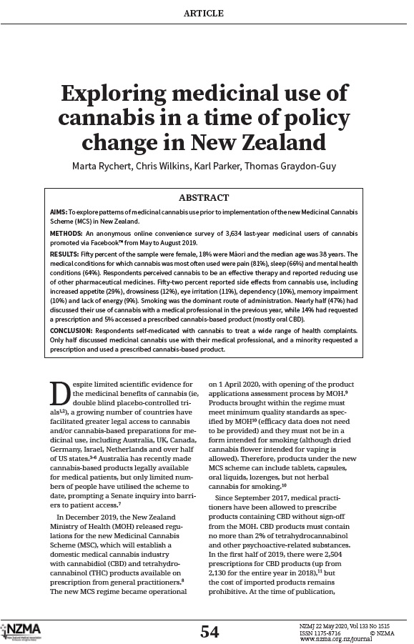
→ 81% Pain conditions (45% backpain)
→ 66% Sleep conditions (55% insomnia)
→ 64% Mental health (45% anxiety)
→ 17% Gastrointestinal (12% IBS)
12% Neurological (3% epilepsy/seizure)
7% Cancers
Many people substituting prescribed pharmaceutical medications
2 in 3 used “daily or near daily”

Slide 9
1
Notes:
MOH supply data (packs supplied)

Slide 10
1

Slide 11
Do you have a prescription for medicinal cannabis? (NZ Drug Trends Survey) 2020 vs 2022 vs 2024

Slide 12
Do you have a prescription for medicinal cannabis? (NZ Drug Trends Survey) 2020 vs 2022 vs 2024

Slide 13
Do you have a prescription for medicinal cannabis? (NZ Drug Trends Survey) 2020 vs 2022 vs 2024

Slide 14
Do you have a prescription for medicinal cannabis? (NZ Drug Trends Survey) 2020 vs 2022 vs 2024
Current script
Notes:
2024 NZDTS: 1 in 6 (16%) of med can said MAIN source of med can were cannabis clinics or pharmacies.
26% when only considering “all/most” med can users says MAIN source was cannabis clinic and pharmacies!!!

Slide 15
Medicinal cannabis products on the market (9 September 2024 – 47 products)
2
 | CBD-dominant | Balanced THC:CBD | THC-dominant
Oral liquids and sublingual solutions | 13 | 3 | 4
Dried flower – for vaping |  | 1 | 12
Dried flower – tea | 1 |  | 13
61% products THC dominant:
26% THC
<1%CBD
25% THC
<1% CBD
Notes:
47 products as of September 2024
Most THC dominant

Slide 16
Medicinal cannabis products on the market (9 September 2024)
3
 | CBD-dominant | Balanced THC:CBD | THC-dominant
Oral liquids and sublingual solutions | 13 | 3 | 4
Dried flower – for vaping |  | 1 | 12
Dried flower – tea | 1 |  | 13
57% products dried flower:
Notes:
Note edibles / topicals are not on the market

Slide 17
Prescriptions in the past 12 months (May 2023 – April 2024)
3
 | CBD-dominant | Balanced THC:CBD | THC-dominant
Oral liquids and sublingual solutions | 68,055 | 20,062 | 10,046
Dried flower – for vaping |  |  | 29,318
Dried flower – tea | 1,741 |  | 35,757
45% scripts for THC-dominant
Notes:
Note edibles / topicals are not on the market

Slide 18
Prescriptions in the past 12 months (May 2023 – April 2024)
3
 | CBD-dominant | Balanced THC:CBD | THC-dominant
Oral liquids and sublingual solutions | 68,055 | 20,062 | 10,046
Dried flower – for vaping |  |  | 29,318
Dried flower – tea | 1,741 |  | 35,757
45% scripts for THC-dominant
60% scripts for oral drops/liquids
Notes:
Note edibles / topicals are not on the market

Slide 19
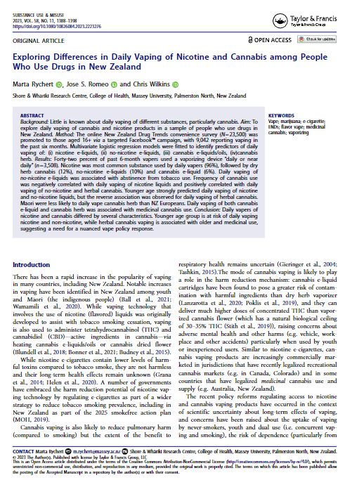
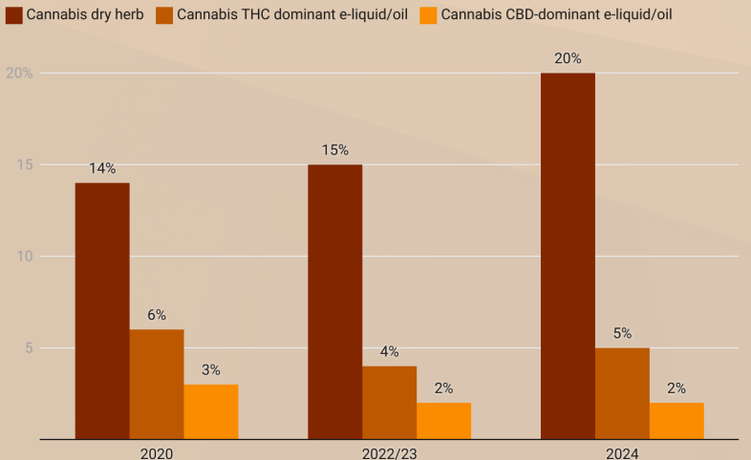
NZDTS: Small increases in cannabis vaping so far… but… nicotine by far the dominant substance people vape.
Vaporizing herbal cannabis is more common than CBD/THC e-liquid vaping in NZ
Do consumers with flower prescriptions vape or….?
Notes:
2024: 25% of cannabis users vaped in the past 6 m Vs 18% in 2020

Slide 20
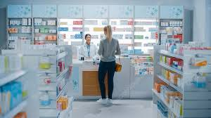

4
Approx 15 NZ$/gram
(cheapest 11 NZ$/gram)
Approx 12 NZ$/gram purchasing an ounce
Notes:
Prices declines

Slide 21
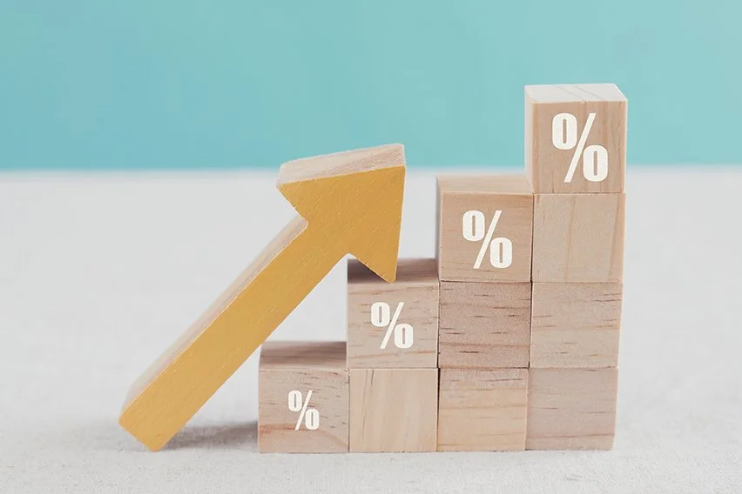
2023/2024
36 Licensed cultivators
53 hectares used for cannabis cultivation
Production volume: 71 tonnes
mid-2020
3 Licensed cultivators
1.3 hectares used for cannabis cultivation
Production volume: 8-15 tonnes

Slide 22
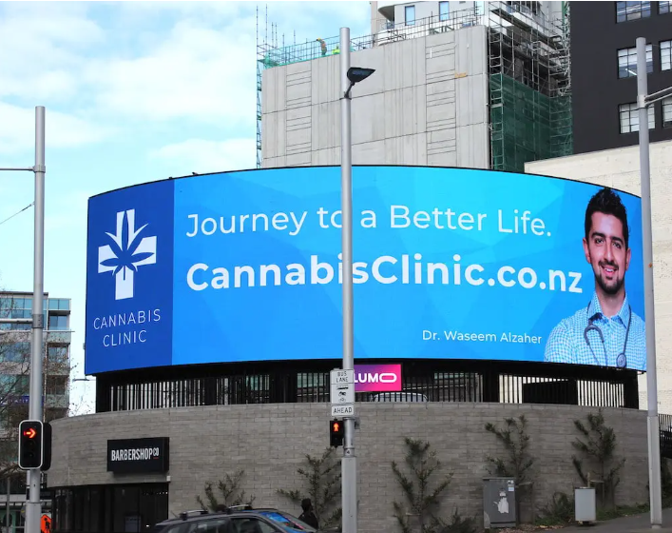
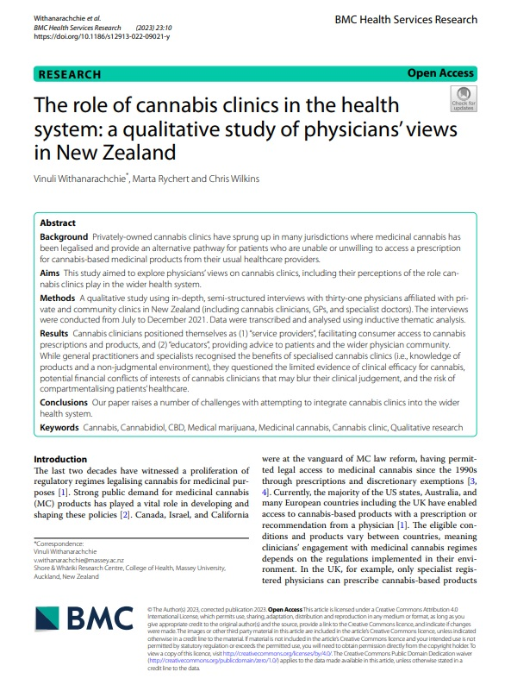
Unintended development due to GPs concerns around prescribing (in 2019/20 only 1 in 3 requests successful)
When I was having trouble with the chap with the gastrointestinal irritation. I contacted them and asked their opinion so I guess I find them useful as a source of knowledge.” (Specialist)
My only concern is that they are providing only one medicine and matching that to problems rather than the other way around which doesn’t seem like the right flow of logic. (GP)
5
Notes:
Cannabis clinics and commercialis

Slide 23
6
Equity of access:
160,000+ prescriptions in the past year
Patients aged 30-39 received most prescriptions (i.e. 26%)
Male patients received more prescriptions than female (58%)

Slide 24
From age 60 women receive more prescriptions than men
12.9% of prescriptions were for patients identifying as Māori

Slide 25
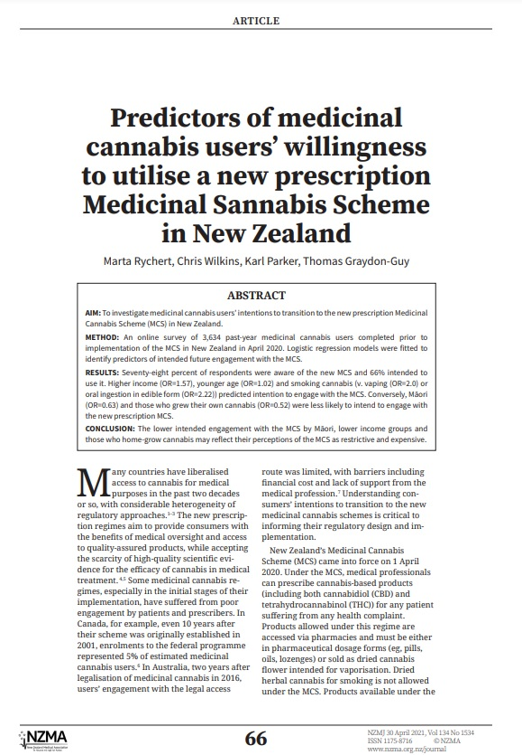
What types of medicinal cannabis users are more likely to use the new medicinal cannabis scheme once it is fully implemented?”
Analysis: Logistic regression models were fitted to identify predictors of intended future engagement with the MCS. The model included: demographic variables, medical conditions, main routes of administration, main source of supply, use of other drugs (including use of cannabis for recreational purposes).
Higher household income (OR=1.6) and younger age (OR=1.02)
Those who administered cannabis via smoking (v. vaping (OR=2.0) or oral ingestion in edible form (OR=2.22)) also more likely to engage.
→ may indicate willingness to transition to less harmful ROA from smoking
Māori (OR=0.63), those who mainly accessed cannabis by growing their own (OR=0.52) less likely to engage
Perceptions of legal medical cannabis scheme as restrictive and expensive?

Slide 26
INCREASING PRODUCTION AND SUPPLY
MORE PRODUCT CHOICE: POTENCY
NEW PRODUCT TYPES: VAPING
6
IMPROVED ACCESS VIA CANNABIS CLINICS
PRICES DECLINED SINCE 2020
BUT EQUITY OF ACCESS ISSUES REMAIN
EMERGING TRENDS

Slide 27
“This bill amends the Misuse of Drugs Act 1975. It is a bill about cultivation, cannabidiol, and compassion”
(…) the defendant has a defence if, at the time of the possession or use, the defendant had been diagnosed by a medical practitioner or nurse practitioner as requiring palliation.
In this Act, a person requires palliation if, in the opinion of a medical practitioner or nurse practitioner, the person has an advanced progressive life-limiting condition and is nearing the end of their life.
(…) a person who has a certificate from a medical practitioner or nurse practitioner certifying that the person requires palliation may procure, possess, consume, smoke, or otherwise use any plant or plant material of the genus Cannabis or any cannabis preparation.
Misuse of Drugs (Medicinal Cannabis) Amendment Act 2018

Slide 28

PATIENTS
LICENSED PRODUCERS
LEGACY GROWERS
HERBALISTS
CANNABIS CLINICS
MEDICAL COMMUNITY
POLITICAL DECISIONMAKERS

Slide 29
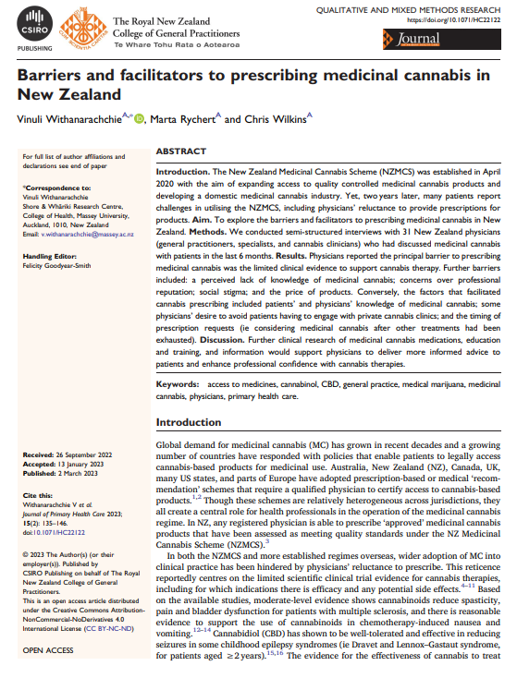
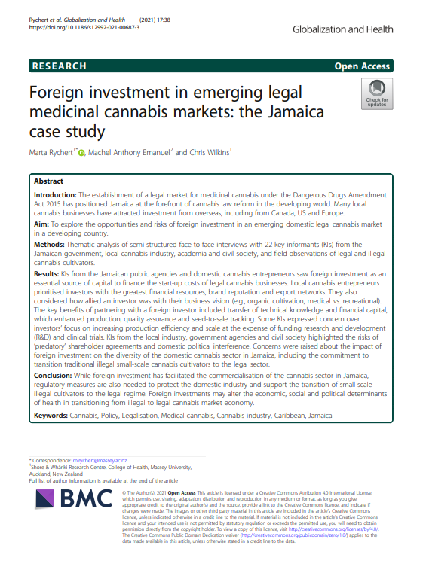
Ngā mihi
m.rychert@massey.ac.nz

Slide 30
References
Adams, P. J., Rychert, M., and Wilkins, C. (2021) Policy influence and the legalized cannabis industry: learnings from other addictive consumption industries. Addiction, 116: 2939–2946.
Fergusson DM, Swain-Campbell NR, Horwood LJ. Arrests and convictions for cannabis related offences in a New Zealand birth cohort. Drug Alcohol Depend. 2003;70:53-63.
Oldfield K, Braithwaite I, Beasley R, et al. Medical cannabis: knowledge and expectations in a cohort of North Island New Zealand general practitioners. N Z Med J. 2020;133
Pledger M, Martin G, Cumming J. New Zealand Health Survey 2012/13: characteristics of medicinal cannabis users. N Z Med J. 2016;129:25-36.
Rychert M, Wilkins C, Parker K, Graydon-Guy T. Exploring medicinal use of cannabis in a time of policy change in New Zealand. N Z Med J. 2020;133:54-69.
Wilkins C, Rychert M, van der Sanden R, et al. Cannabis prices decline as availability increases (NZDTS Research Bulletin - August 2023). 2023.
Withanarachchie V, Rychert M, Wilkins C. Barriers and facilitators to prescribing medicinal cannabis in New Zealand. Journal Prim Health Care. 2023;15: 135-46.
Withanarachchie V, Rychert M, Wilkins C. The role of cannabis clinics in the health system: a qualitative study of physicians’ views in New Zealand. BMC Health Serv Res. 2023;23:10.

